Slide 1

Handling Files
Notes:
NOTE:
To change the image on this slide, select the picture and delete it. Then click the Pictures icon in the placeholder to insert your own image.

Slide 2
Introduction to Files Concept
So far, we have learned how to write programs and communicate our intentions to the Central Processing Unit using conditional execution, functions, and iterations.
We have learned how to create and use data structures in the Main Memory. The CPU and memory are where our software works and runs. It is where all of the “thinking” happens.
In this chapter, we start to work with Secondary Memory (or files). Secondary memory is not erased when the power is turned off.
In this session, you'll learn about Python file operations. More specifically, opening a file, reading from it, writing into it, closing it and various file methods you should be aware of.

Slide 3

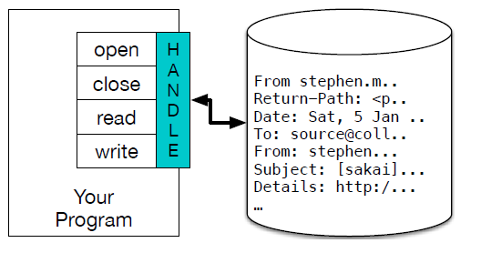
File Operations
The main file operations are:
Opening a File
Reading a File
Writing a File/Appending a File
Closing a File

Slide 4
Opening A File
When we want to read or write a file (say on your hard drive), we first must open the file.
Opening the file communicates with your operating system, which knows where the data for each file is stored.
When you open a file, you are asking the operating system to find the file by name and make sure the file exists.
Syntax to open a File:
>>> fhand = open('mbox.txt')➔ open(“filename.ext”,”mode(r,w,a)”)
>>> print(fhand)
<_io.TextIOWrapper name='mbox.txt' mode='r' encoding='cp1252'>

Slide 5
Writing a File
To write a file, you have to open it with mode “w” as a second parameter:
Syntax for Writing a File:
>>> fout = open(‘mbox.txt', 'w')
>>> print(fout)
<_io.TextIOWrapper name='output.txt' mode='w' encoding='cp1252'>
>>> line1 = "This here's the wattle,\n"
>>> fout.write(line1)
24
>>> fout.close()

Slide 6
Reading a File
To write a file, you have to open it with mode “r” as a second parameter:
Syntax for Reading a File:
>>> fread=open("mbox.txt","r")➔ open(“filename.ext”,”r”)
>>> print(fread)
<_io.TextIOWrapper name='mbox.txt' mode='r' encoding='cp1252'>
>>> inp=fread.read()
>>>print(inp)

Slide 7
Appending Data into a File
To append data into a file which already exists, “a” (append) mode of operation is used.
Syntax To Append Data into a file:
>>>append=open(“mbox.txt”, ”a”)
>>>append.write(“Appending Data into File “)
>>>append.close()
After appending data into the file, repeat the file reading process to the availability of the appended data.

Slide 8
Letting the User Choose the File Name
fname = input('Enter the file name: ')
try:
fhand = open(fname)
except:
print('File cannot be opened:', fname)
exit()
count = 0
for line in fhand:
if line.startswith('Subject:'):
count = count + 1
print('There were', count, 'subject lines in', fname)

Slide 9
Using Try, Except, and Open
fname = input('Enter the file name: ')
try:
fhand = open(fname)
except:
print('File cannot be opened:', fname)
exit()
count = 0
for line in fhand:
if line.startswith('Subject:'):
count = count + 1
print('There were', count, 'subject lines in', fname)

Slide 10
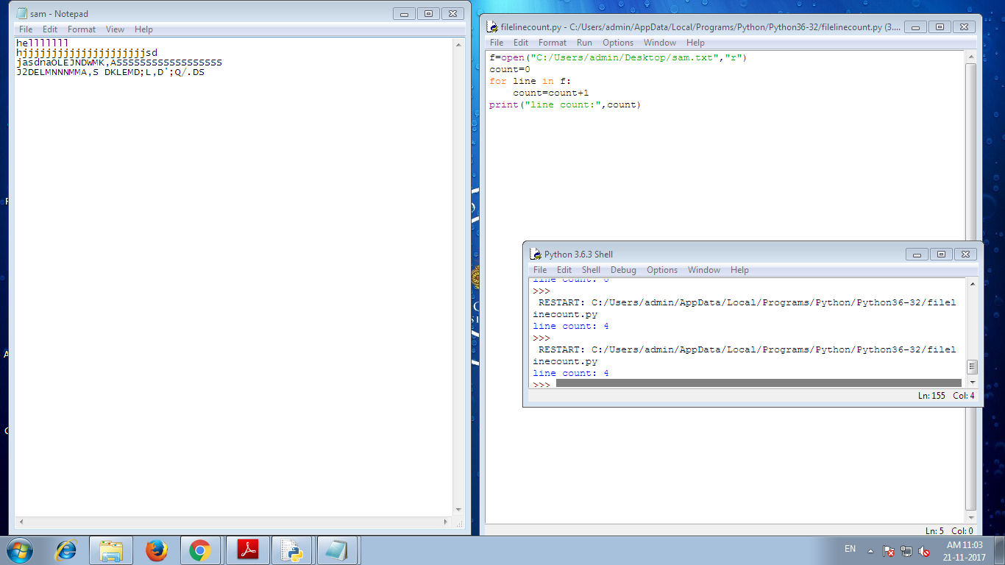
Finding number of lines in a file

Slide 11
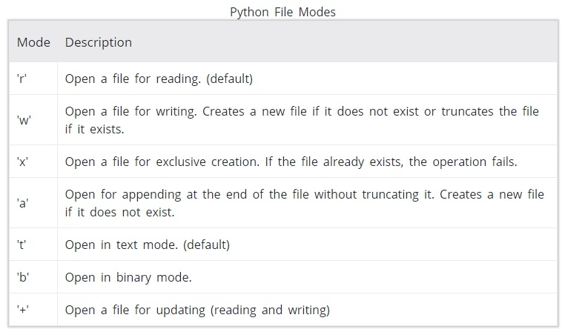
Summary

Slide 12
Exercise
What is a file?
What are the file operations ?

Slide 13
THANK YOU ALL!!
QUESTIONS PLEASE?
Notes:
NOTE:
To change the image on this slide, select the picture and delete it. Then click the Pictures icon in the placeholder to insert your own image.

